Slide 1

1. Recent advancements
“€4.6 million from the European Commission for smart water research”
Aqualia requests millions from the EC to further support our R&D

Slide 2
1. Recent advancements
“€20 million for smart water monitoring and control systems for the 2022 World Cup”
Improving networks in the Middle East

Slide 3
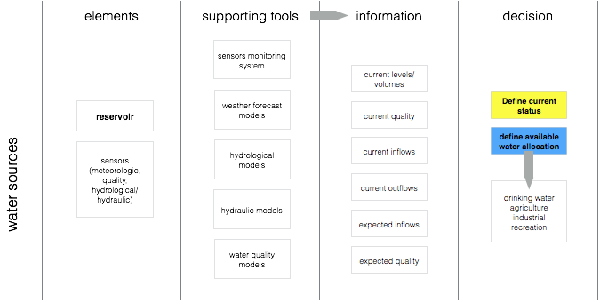
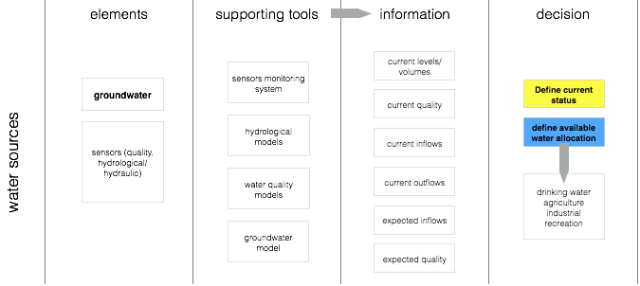
Concepts related to reservoirs management
Protecting and managing water supplies
3
Notes:
…

Slide 4
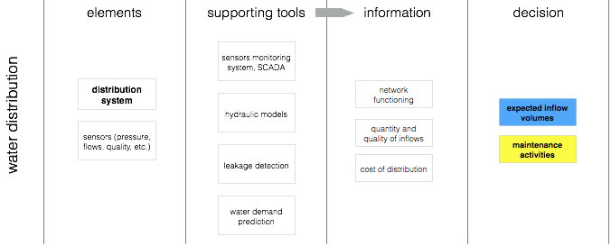
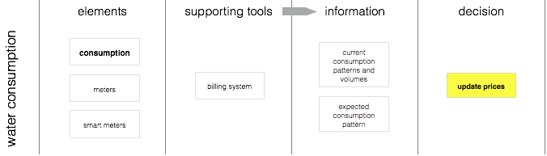
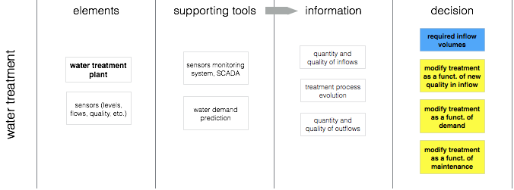
Concepts related to water distribution systems management
Protecting and managing water supplies
4
Notes:
…

Slide 5
1. Recent advancements
“Recent high profile pilot announcements in the UK, Spain and Portugal”
European Commission supporting pilots in Europe

Slide 6
1. Recent advancements
“Partners around the world from Microsoft Research to universities”
Working with business and academia to develop the best technologies

Slide 7
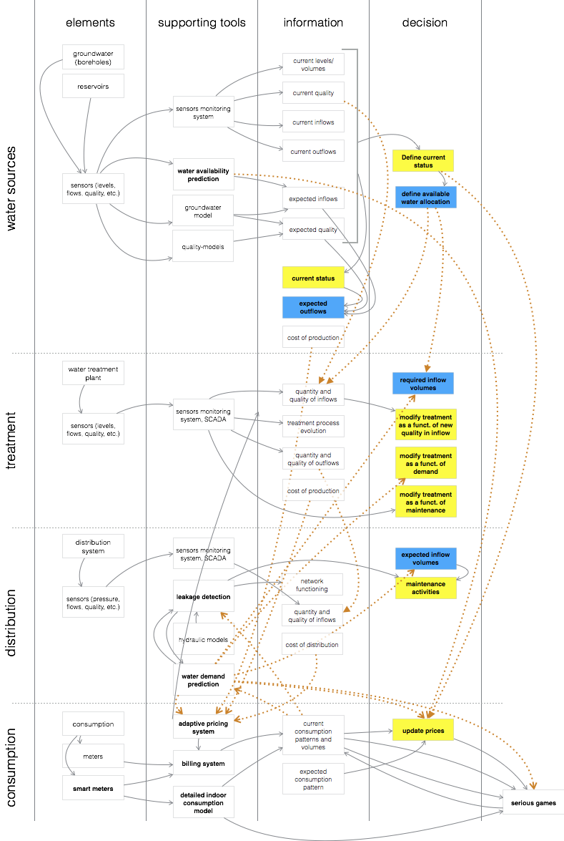
An integrated solution
Bringing together expertise and solutions
Water Sources
Managing water supplies across rivers, reservoirs and wetlands
Water Treatment
Effective treatment of water to provide clear safe water
Water Distribution
Reducing water loss and maintaining water quality
Water Consumption
Managing demand, modifying consumer behaviour, meeting demand
7
Notes:
…

Slide 8
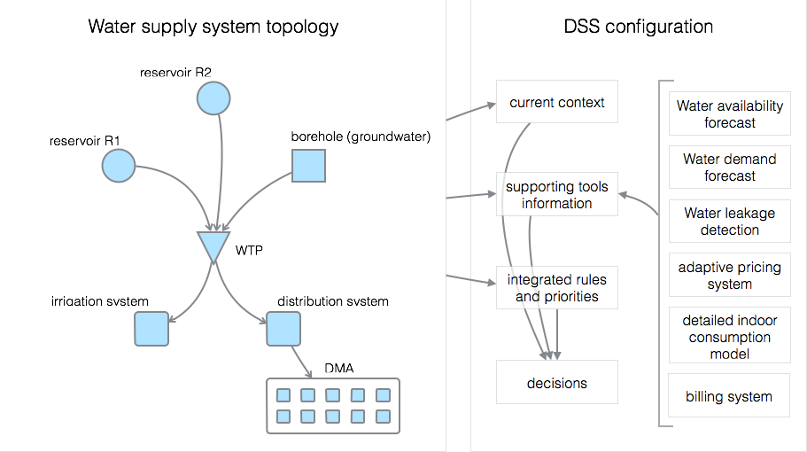
An integrated solution
Decision Support System
8
Notes:
…

Slide 9

SODA Platform
One Open Platform supporting all Smart applications
Many challenges, many disparate smart applications
Data pooled and shared between applications
Data logger, meter and SCADA data pooled and made available to any client approved smart application
Extensive third party smart application library
Predictive systems to smart leak detection services from companies around the world
Easy data access
Open Data interfaces as well as optimised parallel API’s for large files and direct table access
State of the art security
Security developed with partners such as Microsoft. Active R&D program into Homomorphic encryption.
World’s most robust and trusted data centres or on-site hosting
Hosting options include on-site, Microsoft Azure data centres are partitioned hybrid hosting
✓
✓
✓
✓
✓
✓
9

Slide 10
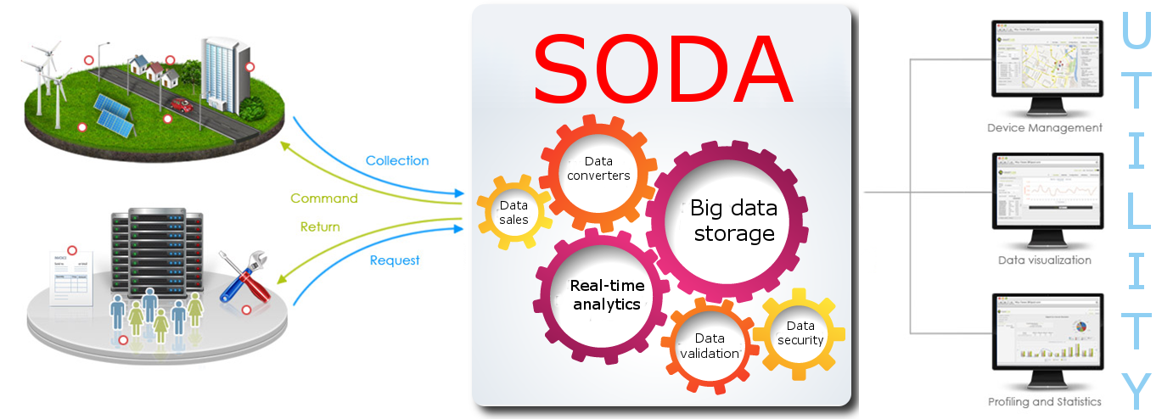
SODA powering water networks
Data management is at the heart of all Smart Systems
Data Collection
Data collected from any data source including data loggers, meters, SCADA systems and remote datasets
Data Validation
Checking data for errors and patterns such as underreporting meters
Data Storage
Data stored securely onsite, in the cloud or a mix of the two
Data Access
Access to data through an Open Data or bespoke web API, direct table access, BLOB API’s and other access methods
Service Bus
Applications working together collaboratively
Illustrative savings for European Water Utility
Year | 1 | 2 | 3 | 4 | 5
Savings | €150.5m | €170.4m | €190.3m | €200.5m | €210.7m
Costs | €30.1m | €27.7m | €28.1m | €28.7m | €29.3m
Total Benefit | €120.4m | €142.7m | €162.2m | €171.8m | €181.4m
ROI | 400% | 516% | 576% | 598% | 619%
10
Notes:
…

Slide 11
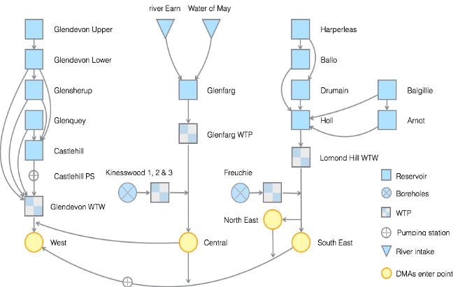
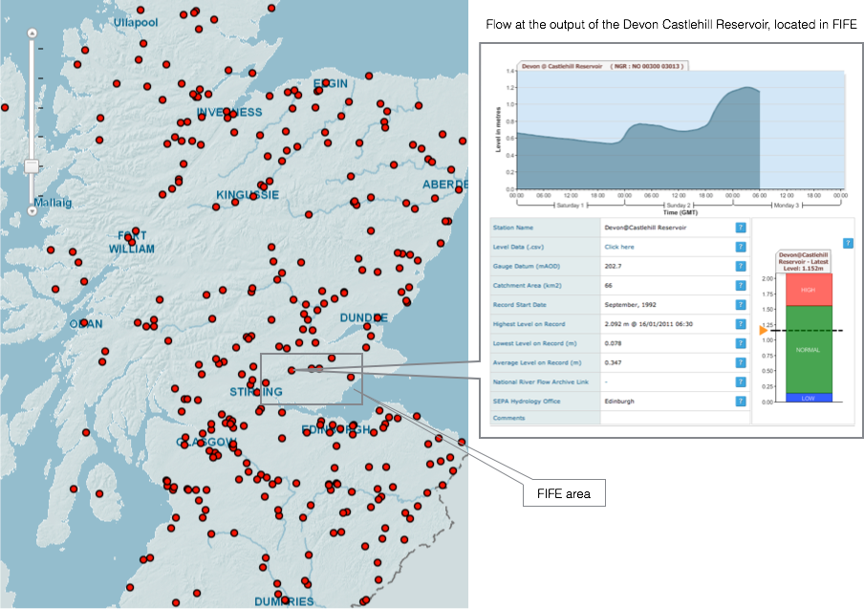
Secure yet Open Data Architecture (SODA)
A stable, secure, layered data management platform with an open data API
UK
Management of full water chain at utility in the UK
Protecting water sources
Reservoirs and ground water supplies
Monitoring and predictive services
Protecting water distribution networks
Smart leak detection and network monitoring systems
Real-time decision support systems protecting the network
Meeting demand
Monitoring and predicting water demand
Consumer engagement tools, adaptive pricing, billing and gaming
Europe
Middle East
China smart leak detection
Smart cities in China
Source: […]
11
Notes:
[trade-in customers shop 5x more frequently and generate 4x more value than non trade-in customers]
…

Slide 12
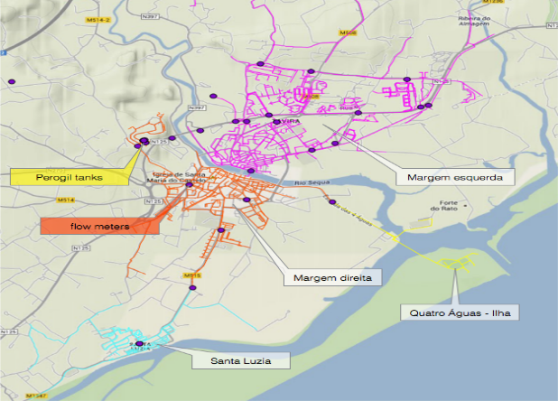
Secure yet Open Data Architecture (SODA)
A stable, secure, layered data management platform with an open data API
UK
Management of full water chain at utility in Portugal
Protecting water sources
Reservoirs and ground water supplies
Monitoring and predictive services
Protecting water distribution networks
Smart leak detection and network monitoring systems
Real-time decision support systems protecting the network
Meeting demand
Monitoring and predicting water demand
Consumer engagement tools, adaptive pricing, billing and gaming
Europe
Middle East
China smart leak detection
Smart cities in China
12
Notes:
[trade-in customers shop 5x more frequently and generate 4x more value than non trade-in customers]
…

Slide 13
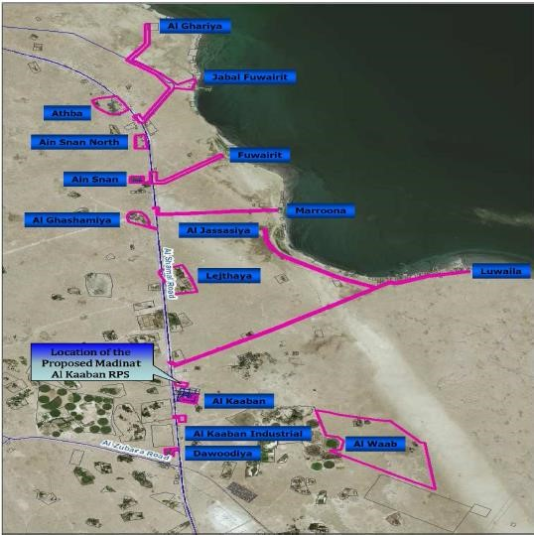
Secure yet Open Data Architecture (SODA)
A stable, secure, layered data management platform with an open data API
UK
Management of full water chain at utility in the Middle East
Protecting water sources
Water Quality
Water supply
Protecting water distribution networks
Smart leak detection and network monitoring systems
Real-time decision support and network control systems
Water Quality
Maintaining water quality
Identifying risks and working with environmental agency systems
Europe
Middle East
China smart leak detection
Smart cities in China
13
Notes:
[trade-in customers shop 5x more frequently and generate 4x more value than non trade-in customers]
…

Slide 14
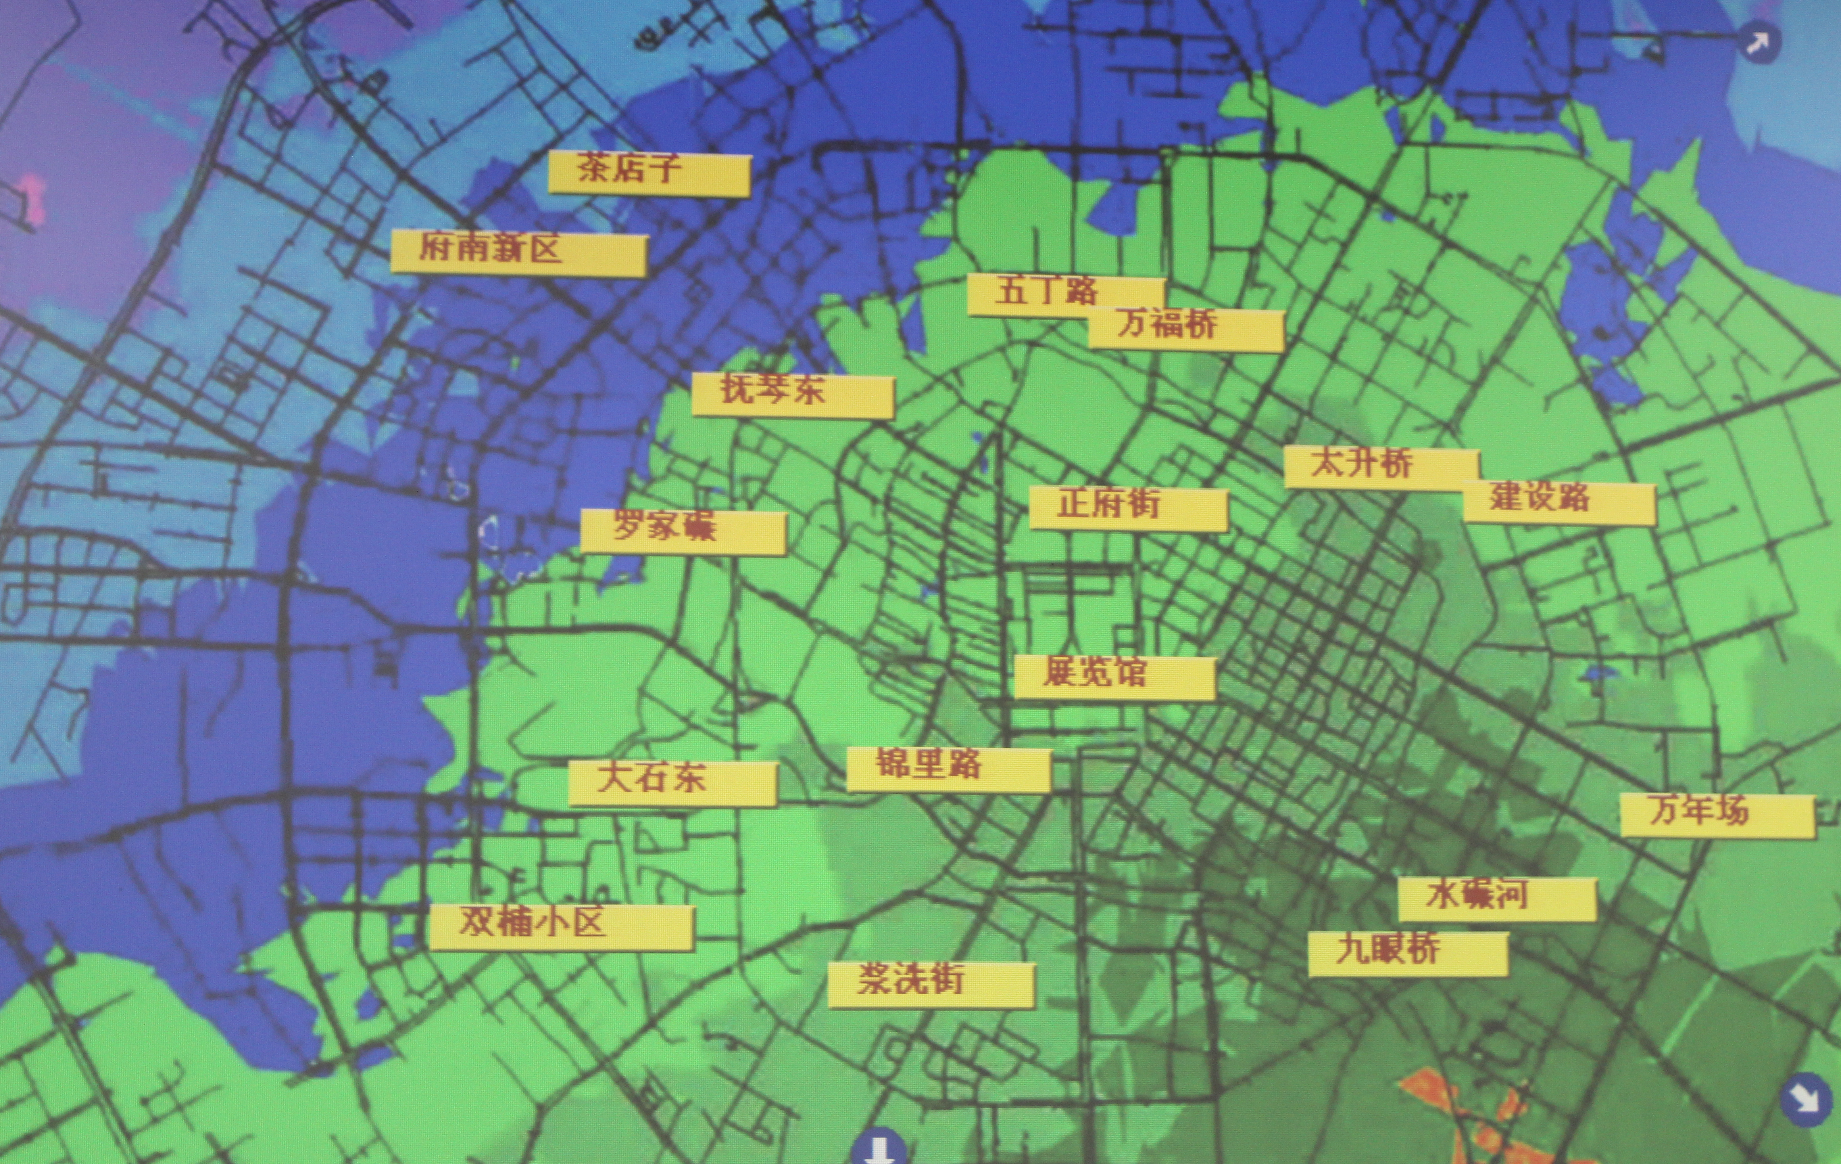
Secure yet Open Data Architecture (SODA)
A stable, secure, layered data management platform with an open data API
UK
Smart leak detection in China
Low cost automated leak detection
Rapidly locate leaks automatically
Work with field engineers
Reporting services
Keep departments updated
Information where it’s needed
Rich monitoring
Real time monitoring and live views.
Flow and pressure data
Water quality data
Europe
Middle East
China Smart leak detection
Smart cities in China
14
Notes:
[trade-in customers shop 5x more frequently and generate 4x more value than non trade-in customers]
…

Slide 15
Secure yet Open Data Architecture (SODA)
A stable, secure, layered data management platform with an open data API
UK
Food Quality, energy with China State Grid and more
Wind farms
Monitoring the wind field around wind farms
Real-time configuration of turbines
Increased energy production, reduced strain
Food Quality
Remote monitoring of food production and distribution
Automated alerts of safety issues
Manufacturing
Working with meter manufacturers to drive up quality and improve security
Working with partners to support local business to tackle national challenges
Europe
Middle East
China smart leak detection
Smart cities in China
15
Notes:
[trade-in customers shop 5x more frequently and generate 4x more value than non trade-in customers]
…

Slide 16








2. MARKET LEADER
Red Skies - offering something completely different to the competition
 | SODA | Smart Cities Corporates | Meter makers | Small independent suppliers | Specialised smart systems
Range of services
Cloud or on-premises
Open Data
Connect any smart system
Scale to any size
Extreme security
Value
Smart system neutral / independent
✗
✗
✗
✗
✗
✗
✗
✗
✗
✗
✗
✗
✗
✗
Red Skies position | The leading smart utility platform | Costly, closed systems which don’t support third party suppliers | Focus on hardware with limited data and smart system support | Closed systems with no 3rd party support, limited security and scale | Focused on single smart system, limited scalability or flexibility
16

Slide 17
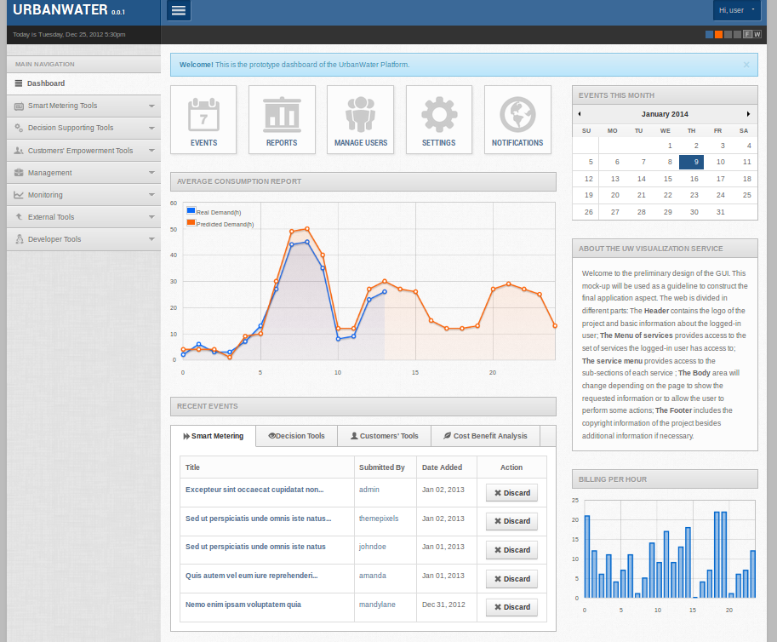
Some example systems
The core platform that integrates many smart applications
Water Demand Prediction
24 hour, 365 day per year demand prediction using historic and live data with an AI engine
Water Availability Prediction
Short to Long term water availability using many data sets and powerful modelling capabilities
Automated Leak Detection
Multiple leak detection applications
Decision Support System
Combines the outputs of multiple apps to advise on or control water networks
Customer Empowerment
Consumer applications
17
Notes:
…

Slide 18
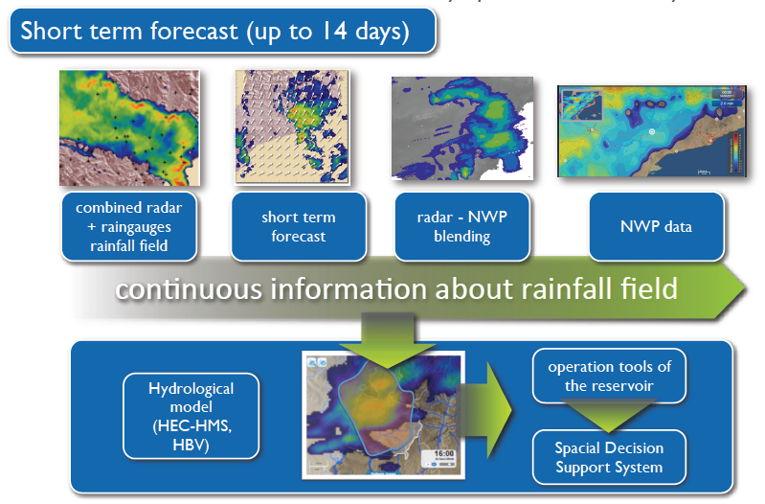
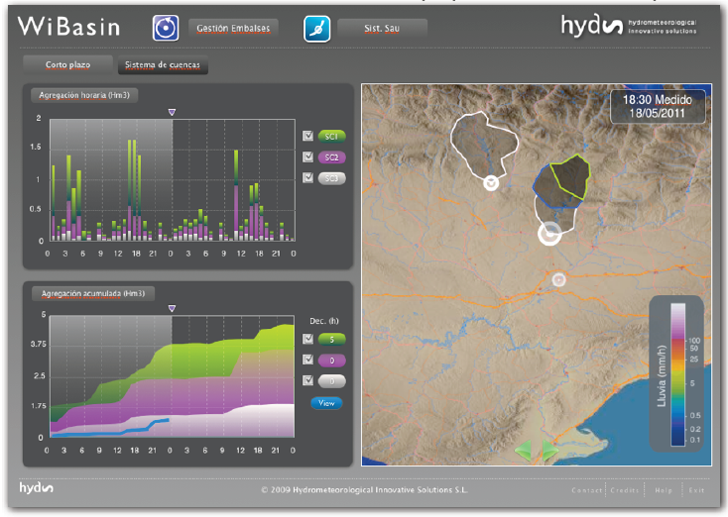
What is Smart Data Management
Data management is at the heart of all Smart Systems
Serious Games
Consumer gaming that uses real-time water network data
Adaptive Pricing Engine
Adaptive tariff engines for helping to change consumer behaviour
Real-time billing
Real-time billing, necessary for adaptive pricing
Head end & SCADA systems
Integration into head end and SCADA systems
Control Systems and more
From pressure management to water quality monitoring systems, there are new smart applications being added all the time
18
Notes:
…

Slide 19
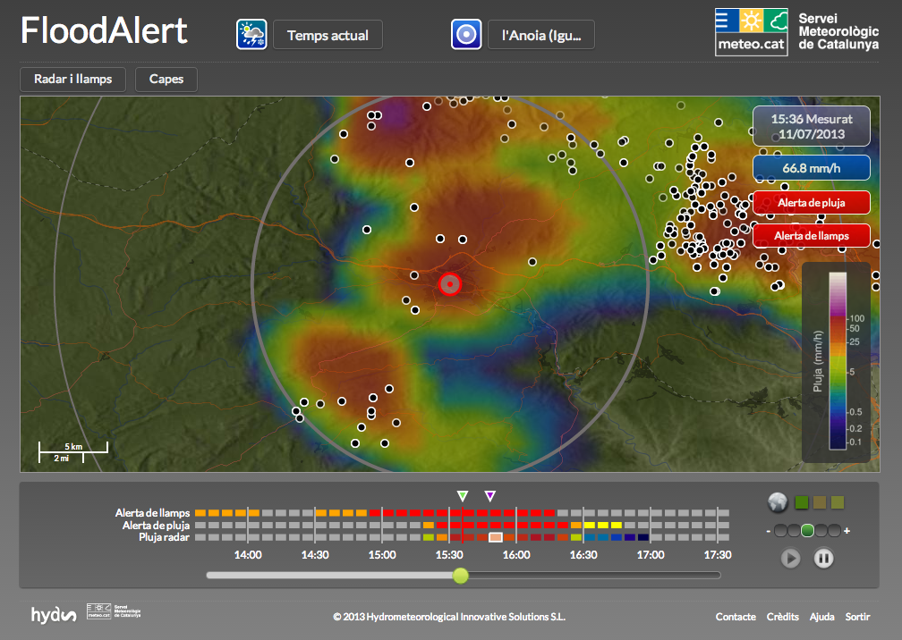
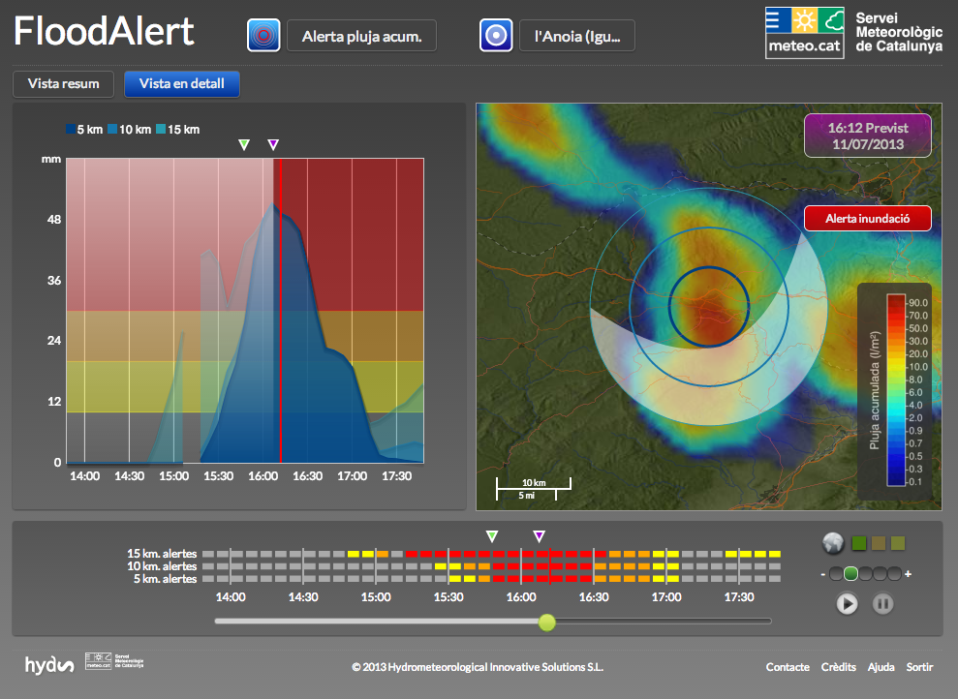
FloodAlert
Typical module for predicting flood events
Urban flood Early Warning System
Low cost, online based module for easy configuration and use
Real time
Real time radar observations, the nowcasting for the following 2h, and lighting information (circles).
Alerts
Warning over instantaneous precipitation estimations can be set (level of warning shown in colours in the lower bar)
Feed into DSS
Outputs can feed straight into a decision support system such as that in UrbanWater
19
Notes:
…

Slide 20
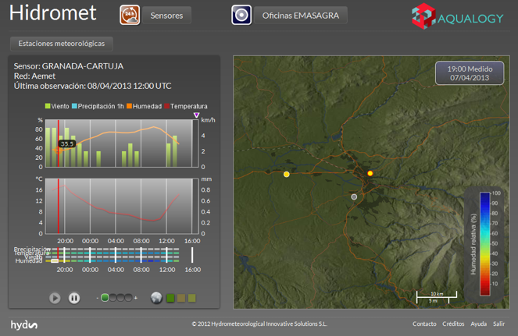
Hidromet
Typical module for predicting flood events
Real time Early Warning System
Real time radar observations and raingauges for fast leadtimes.
Forcasting
10 minutes to several hours
Hydraulic models
Feed into Hydraulic models to model sewer network behaviour
20
Notes:
…

Slide 21
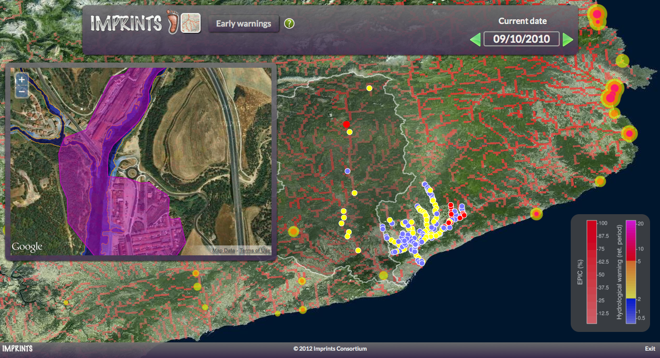
IMPRINTS (IMproving Preparedness and RIsk maNagemenT for flash floods and debriS flow events)
Reducing casualities and economic damage through the improvement of the preparedness and the operational risk management for Flash Flood and Debris Flow (FF/DF) generating events, as well as to contribute to sustainable development through reducing damages to the environment.
Real time Early Warning System
algorithms, tools and methodologies to forecast both Flash Flooding and Debris Flow
Web based
Easy to use and configure web interface
21
Notes:
…

Slide 22
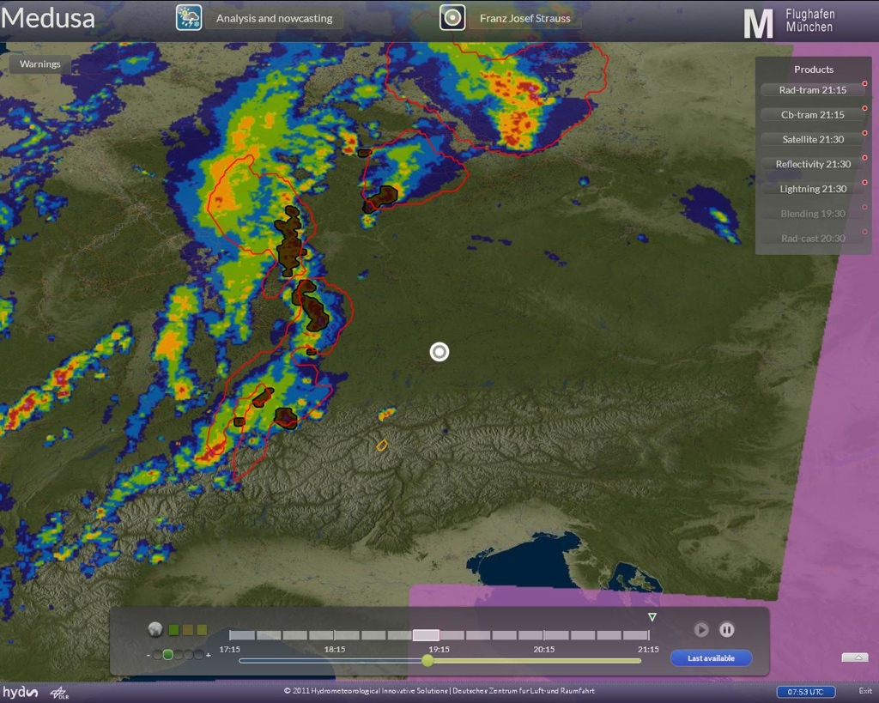
Medusa (MEteorological Decision sUpport System for Aviation)
Reduce incidents, accidents, and delays in air traffic and hence increase safety and efficiency of airport operations
Multiple data sources
Pulling together data from multiple data sources
Data to information
provide adequate information about adverse weather situations to all decision makers in the airport environment such as airports, air navigation safety providers, airlines, and weather services.
22
Notes:
…

Slide 23
Water Availability and Demand Prediction | Elasticity to scale to meet demand | EC Funded pilots in UK and Portugal plus application in Spain
Up to €210m* projected savings by one utility | £16m Middle East pilot for 2022 World Cup | €4m from European Commission over 2.5 years

